Slide 1
06 | Advanced Design
Jeremy Likness | Principal Architect
Christopher Harrison | Content Developer

Slide 2
Module Overview
Parameter binding
Type Converters
Model Binding
Versioning
Azure API Services
Conclusion

Slide 3
Parameter Binding
One parameter to bind them all …

Slide 4
Parameter Binding
Simple parameters come from URI
Primitives (int, bool, double, etc.) along with TimeSpan, DateTime, Guid, decimal, and string
Complex parameters are typically read from the body and passed to the meda-type formatter
Force a complex type to the URI with [FromUri]
Force a simple type to the body with [FromBody]

Slide 5
Parameter Binding
Notes:
01aParameterBinding /api/vectors
Use querystring?name= or standard/name then:
/api/vectors/backwards?Origin.X=1&Origin.Y=2&Origin.Z=3&Direction.X=1&Direction.Y=2&Direction.Z=3
Content-Type application/json and raw content = “test”

Slide 6
Type Converters
In case you’re not my type

Slide 7
Type Converters
When exists, treats as simple type
Decorate the class with it’s type converter
Derive from TypeConverter
CanConvertFrom (string) [Set CanConvertTo to False!!!]
ConvertFrom (implement it)
You control the format, but remember it is passed as a single parameter
Use TypeDescriptor to add for classes in another library

Slide 8
Type Converters
Notes:
01bTypeConverters
/api/vectors/1|2|3|4|5|6

Slide 9
Model Binding
Turning your POCOs into POJOs

Slide 10
Model-Binding
More specific solution than type conversion
Access to the HTTP Context and actions
Can apply to parameter, type, or register a provider
Implement IModelBinder
BindModel returns false if the model cannot be processed

Slide 11
Model-Binding
Notes:
01cModelBinders
/api/vectors/nobinder requires for data (Origin.X, etc.)
/api/vectors/binder can take a ?vector=1|2|3|4|5|6 post

Slide 12
Versioning
Wait? You mean your APIs get updates?

Slide 13
Versioning Scenario
v1
You thought there would only be three types of dates
So you returned a single object
v2
Things change (surprise!) and now you may have 1..n dates
{id, type, date}
{ id, fooDate, barDate, widgetDate }
So you return a set of rows instead with a date type

Slide 14
Versioning
Must-have feature for publicly consumed API
Good to have feature even if it is internally consumed
There is no one accepted standard, but several approaches that you can support:
Part of the path, i.e. /api/v1/versions
Parameter, i.e. /api/versions?version=v1
Accept, i.e. application/v1+json or application/json;v=1
Request header, i.e. version 1.0
There are several approaches

Slide 15
Versioning
Notes:
06dVersioning
/api/things, /api/v2/things, /api/v1/things, header Version 1, header Accept application/xml, header Accept application/xml;Version=1
/api/versions (use same request headers)

Slide 16
Azure API Services
Take your Web API to the cloud and beyond

Slide 17
Azure API Services (Management)
Create a public portal for consumption of the API
Will “wrap” your API with an Azure-managed one
Adds security, access, discovery, descriptions, and more
Can charge for access to services
Secured via a variety of methods
Transform SOAP to REST and vice versa
Export definitions in WADL and Swagger
Analytics

Slide 18
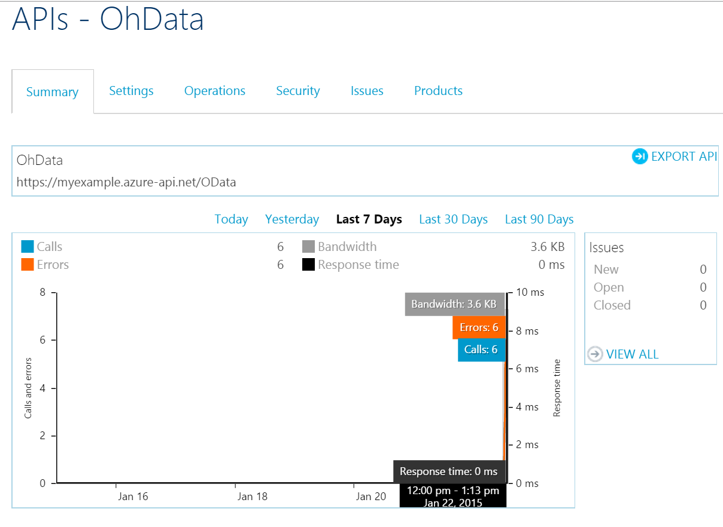
Analytics

Slide 19
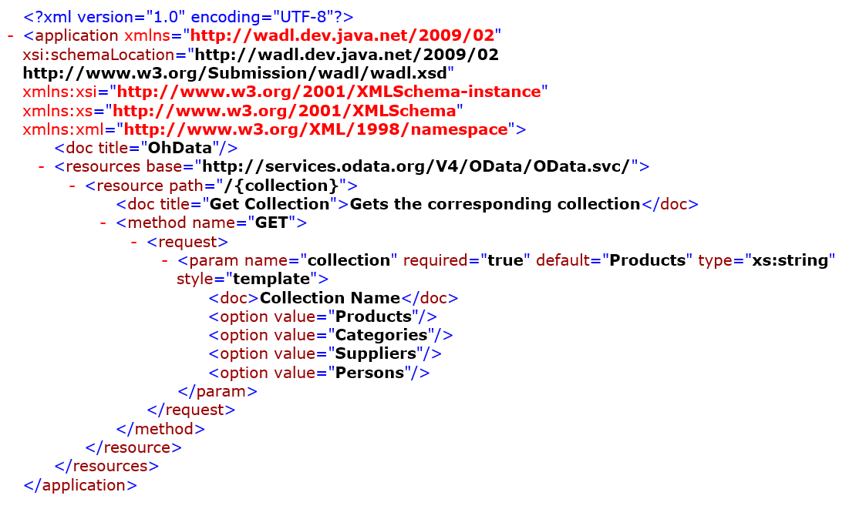
WADL (Web Application Description Language)

Slide 20
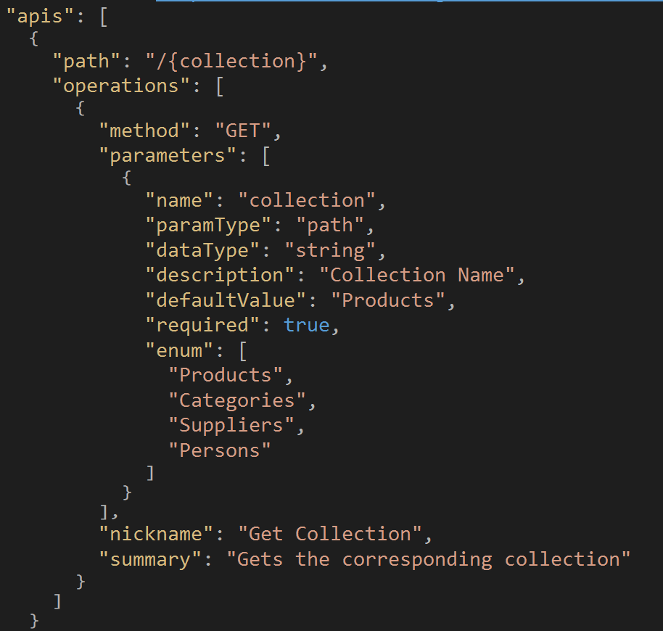
Swagger

Slide 21
Conclusion
“Now that you’re gone, some will grieve on, on, and on…”

Slide 22
Conclusion
Go out and design great APIs!
@JeremyLikness http://csharperimage.jeremylikness.com
@GeekTrainer
Thank you!

